Slide 1
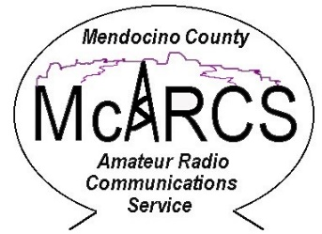
Amateur Radio Presentations
These presentations are sponsored by:
Mendocino Auxiliary Communications Service
Office of Emergency Services
(MACS)
Mendocino County Amateur Radio Communications Service
(McARCS)
Willits Amateur Radio Society
(WARS)

Slide 2
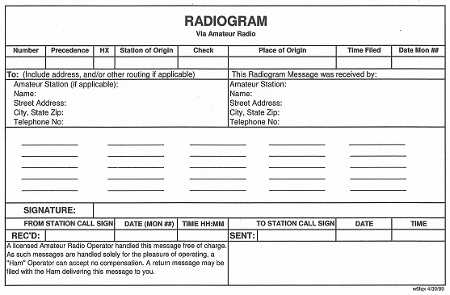
ARRL Radiogram
The ARRL Radiogram is the official
form used by radio operators on the
National Traffic System (NTS).
It can also be used on emergency
radio nets when another specific
form is not required.

Slide 3
ARRL Radiogram - Preamble
The Preamble shall include:
Number (number of message in sequence for each station)
Precedence (Emergency, Priority, Welfare or Routine)
Station of Origin (first amateur handler or tactical call sign)
Check (number of words/groups in message body text only)
Place of Origin (city and state)
Time filed (in 24 hour clock)
Date (day/month)
The box marked HX is for handling instructions. These will not be used for messages on the emergency net.

Slide 4
ARRL Radiogram - Precedence
The radiogram has four levels of precedence:
EMERGENCY: This is a message reporting a life or death situation that requires an immediate response. EMERGENCY messages have priority over all other traffic on the net. A station with an EMERGENCY message may break into a net at any time to send their message. This is done by announcing “BREAK, BREAK, BREAK”.
“P” – Priority: These are important messages that have a specific time limit and will include most official traffic that is not emergency precedence.
“W” – Welfare: These are messages that inquire about the health and welfare of an individual or are a response to a health and welfare inquiry.
“R” – Routine: All messages that are not one of the above priorities. These messages will be handled last, or not at all if frequencies are busy.

Slide 5
ARRL Radiogram - Check
The box for “check” is used to designate the total words/groups in the body of the message. This allows the receiving station to determine if they have received the entire message.
A telephone number is handled as, and counted as, three groups (i.e. 707 555 2121).
The “X” (for X-RAY or a period) is also counted as a group.
The signature is a separate box and is not counted as one of the 25-word groups in the message.

Slide 6
ARRL Radiogram - Address
If the message is between emergency stations (EOC, medical facilities, shelters, etc.), the tactical call sign is sufficient information for the “TO” and “RECEIVED” addresses.
If the message is a health and welfare message and is directed to a specific person, all of the “TO” information should be completed. An email address can be substituted for the telephone number.

Slide 7
ARRL Radiogram – Body of Message
Example of a health and welfare message with a check count of 22.
Robin am fine at Willits____
shelter x will call when ____
phone restored x call Michelle__
707 555 2121 let her __
know x _______ ________ ________
The signature box can contain any identifying information for the party sending the message (i.e. Mike, Brother John, Rod parcel 5, etc.)

Slide 8
ARRL Radiogram – Simplex Relay
The origination station completes the Radiogram and fills in the “SENT” box with the station call sign of the first relay station.
The first relay station copies the Radiogram and enters the following information.
Their call sign in the “received by” box, the sending station in the “REC’D” box and the station they are sending to in the “SENT” box.
The only information that will change as the message is relayed are the message number, received by, received from and sent to boxes.
Each succeeding station does the same until the message arrives at the “TO” addressee.

Slide 9
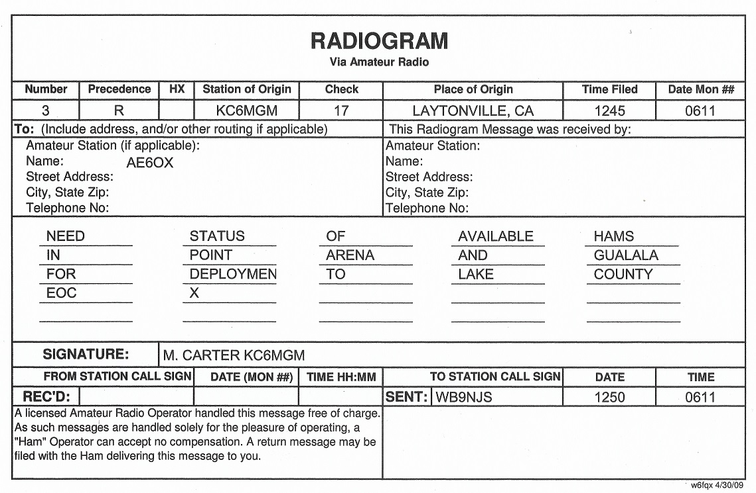
ARRL Radiogram – Simplex Relay Originator

Slide 10
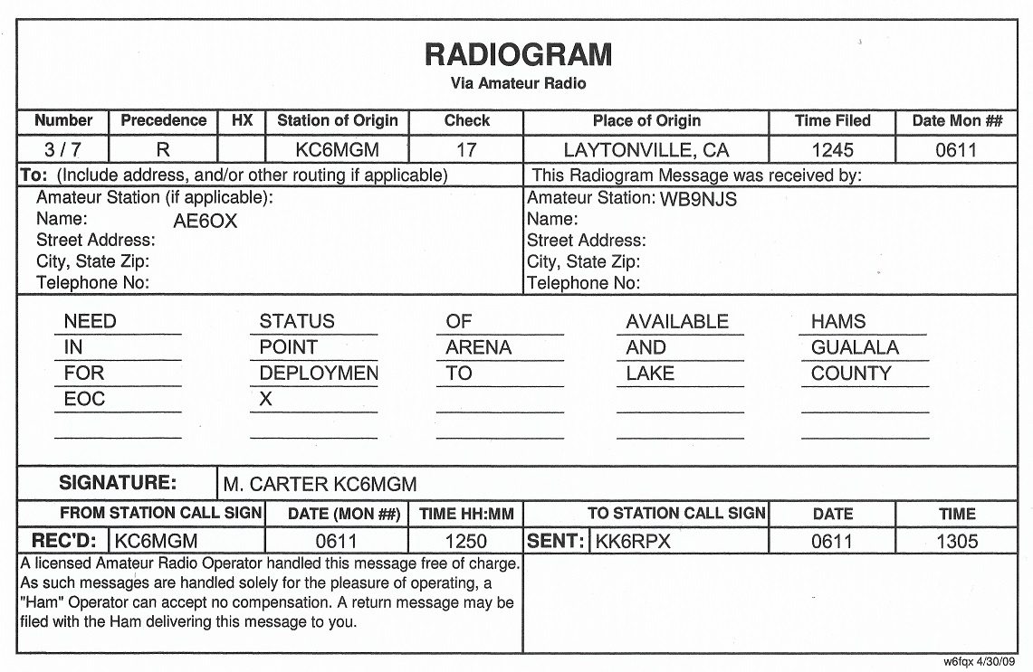
ARRL Radiogram – Simplex Relay First Relay

Slide 11
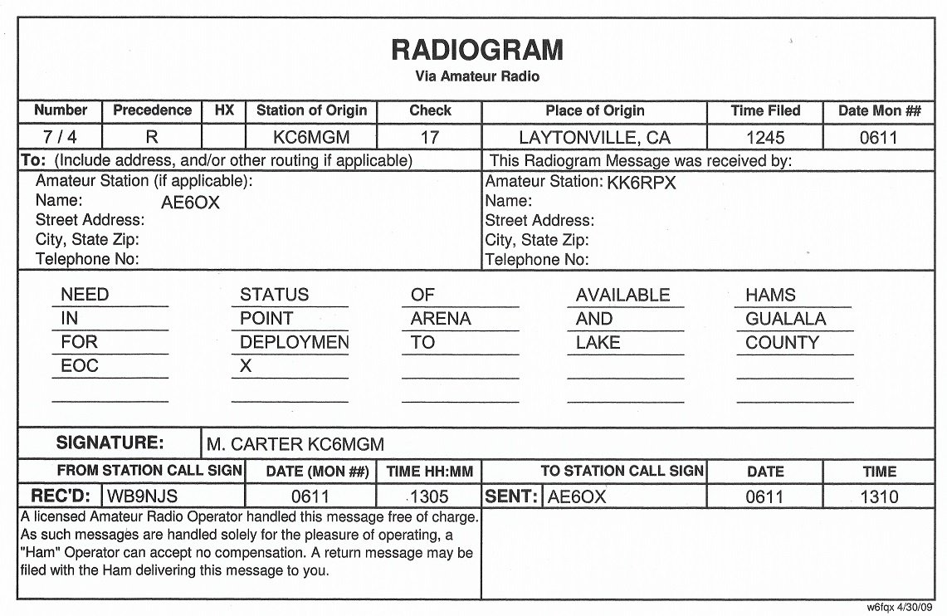
ARRL Radiogram – Simplex Relay Second Relay

Slide 12
Operating Protocols – Sending Speed
The transmitting operator must send clearly and at a speed which will allow the receiving operator to copy perfectly without rushing. Transmit, do not "read", the message. This is one of the hardest skills in traffic handling to master. Use pauses to frame groups clearly.
Assume the receiving operator is copying with pencil and paper unless advised otherwise.
It always takes less time to send a message correctly the first time than it takes to negotiate repeats and fills of missing or uncertain parts. The importance of clearly spaced group sending cannot be overemphasized. It is crucial to correct message copy.

Slide 13
Operating Protocols – Sending Speed cont:
A useful trick to overcome the natural tendency to speak too rapidly is to say a group or phrase, pause, spell it to yourself as though you were writing it, and continue when you visualize that the receiving operator is also finished.
Send in five-word groups with a pause to allow the other operator to catch up with your transmission.
Two stations passing traffic on voice do not have the luxury of duplex operation like you have on the telephone. You must work together using the skills that come from proper training and experience to know what each other is doing without direct feedback. This is the primary purpose of standard protocols.

Slide 14
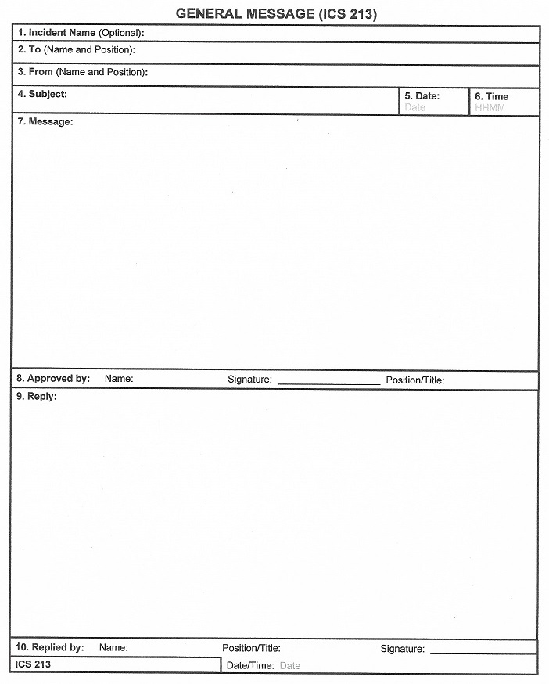
ICS 213 Message Form
The General Message (ICS 213) is used by incident personnel to transmit and record messages that cannot be orally transmitted to the intended recipients.
The ICS 213 is used by the Incident Communications Center for transmission via radio or telephone to the addressee.
This is a three part form.

Slide 15
ICS 213 Message Form cont:
Usage. This form is used to send any message or notification to incident personnel that requires hard-copy delivery.
Preparation. The ICS 213 may be initiated by incident dispatchers and any other personnel on an incident.
Distribution. Upon completion, the ICS 213 may be delivered to the addressee and/or delivered to the Incident Communication Center for transmission.
Documentation. One copy of the ICS 213 should be maintained by the radio operator for inclusion with the radio log when submitting the forms to the documentation unit at the conclusion of the emergency.

Slide 16
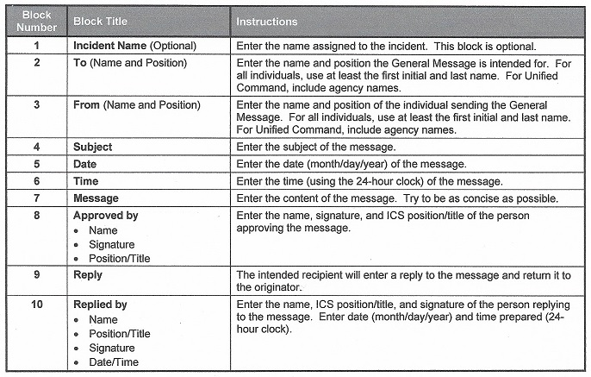
ICS 213 Message Form cont:

Slide 17
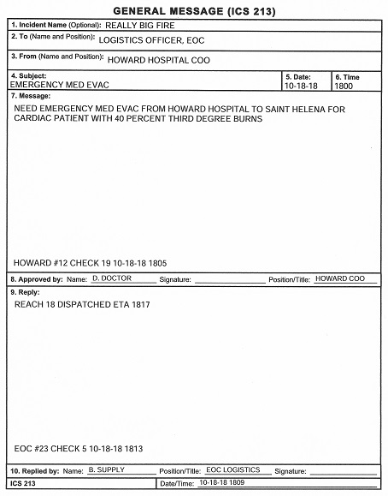
ICS 213 Message Form Example

Slide 18
ICS 213 Message Form – Message Filing
The station will have two folders for messages – one for completed messages and one for pending messages.
The completed message folder will contain the copies of all messages that require no response. (i.e. hospital status reports, change of shift information, road closure information.)
The pending message folder will contain copies of the messages that require a response. (i.e. supply and equipment requests, emergency response requests, requests for status reports.)

Slide 19
ICS 213 Message Form - Originating Station
The message originator will keep the copy 3 and sent the original and copy 2 to the radio operator.
Upon receipt from the originator, the radio operator will write the tactical call sign, the next outgoing message number, the check number, and date and time in the bottom of Box 7.
The radio operator will transmit the message and file the two copies in the pending message folder. The radio operator will enter the message in the Communications Log.
Upon receipt of a response, the radio operator will retrieve the original copies from the pending message folder and complete the response in Box 9 to include the tactical call sign, message number, check number, and date and time in the bottom of the box.
The radio operator will send the original to the originator and file copy 2 in the completed message folder. The radio operator will enter the response in the Communications Log.

Slide 20
ICS 213 Message Form - Receiving Station
Upon receipt, the radio operator will write the originating station tactical call sign, the message number, the check number, and date and time in the bottom of Box 7.
The radio operator will send the original and copy 2 to the recipient and file copy 3 in the pending message folder. The radio operator will enter the incoming message in the Communications Log.
Upon receipt of the response, the radio operator will write their station tactical call sign, next outgoing message number, check number, and date and time in the bottom of Box 9.
The radio operator will send the response to the originator and file copy 2 and 3 in the completed message folder. The radio operator will enter the outgoing response in the Communications Log.

Slide 21
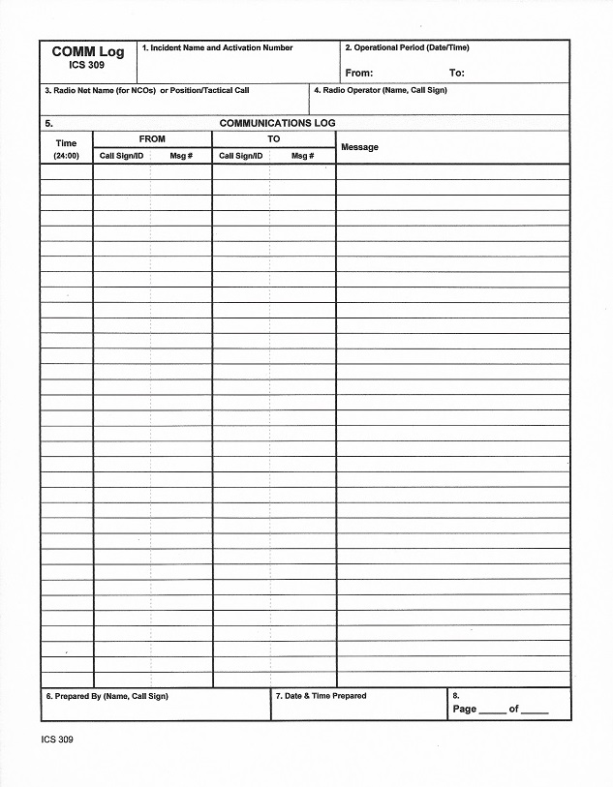
Communications Log
The Communications Log (ICS 309) is used to
record all incoming and outgoing messages.
A communications log will be prepared by each
radio operator at each activated location. Each
radio operator will leave their logs at the
location at the end of their shift.
At the end of the activation, the last radio
operator will attach all of the communications
logs to the message copies and forward the
package to the EOC.

Slide 22
Communications Logs - Completion
The following will be entered on the Communications Log:
Incident name
Operational period (date and time in 2400 clock)
Position tactical call sign
Radio operator (name and FCC call sign)
Received or transmitted message information
Name and call sign of the person preparing the ICS 309
Date and time the ICS 309 is completed
The page number of the ICS 309
Note: The radio operators will enter the sequential page number but leave the “of” blank.
The station closing operator will fill in the “of” section for all pages.

Slide 23
Communications Logs – Message Information
Section 5 of the Communications Log contains the information for the messages.
Incoming and outgoing messages will be recorded on separate lines. This will assist with tracking and routing.
The “FROM” message number will be the message number sent by the transmitting station.
The “TO” message number will be your station next sequential number issued.
The “Message” space is for a brief general description of the message contents.
(i.e. Howard supply request, HHSA sit rep, Ukiah shelter report, etc.).

Slide 24
Communications Logs – Message Information cont:
Other information that results in the transmission of information should also be logged. This would be primarily administrative messages to and from the station.
It would include station activities such as off air and on air times, relief operator ETA, etc.
For administrative messages, use “adm” for the message number.
Administrative messages from other stations, other than the EOC, are not required to be entered in the log unless it is a directed message to your station.
Rule of Thumb: If you transmit anything, log it.

Slide 25
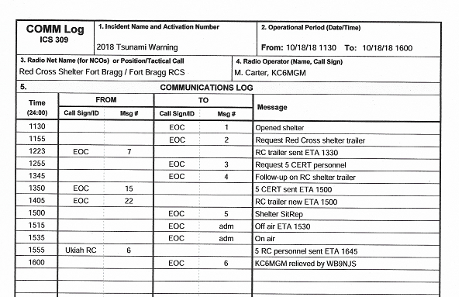
Communications Logs – Example

Slide 26
Other Report Forms
There will be other entities where ham radio operators will be assigned that have their own report forms. These will be primarily medical facilities, shelters and school districts.
The Mendocino Health and Human Services Agency (HHSA) and the Mendocino County Office of Education (MCOE) both have situation reports that will be transmitted primarily between their respective EOC’s and their sub-units.
These report forms should be available at their respective locations, as will the Red Cross shelter forms.

Slide 27
Summary
We have discussed the proper completion of the Radiogram, the ICS Form 213 Message Form and the ICS 309 Communications Log.
In the event of an emergency, such as a power shutoff or fire, these are the primary forms that will be used for message traffic by the EOC, HHSA and MCOE.
They will also be the forms used for health and welfare messages from shelters.
We are in the process of providing a packet with Radiograms, Communications Logs, instruction sheets and even two pre-sharpened pencils to health care facilities and school districts. They should be located with the radios.

